Slide 1
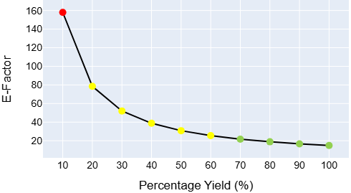
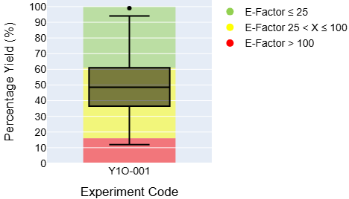
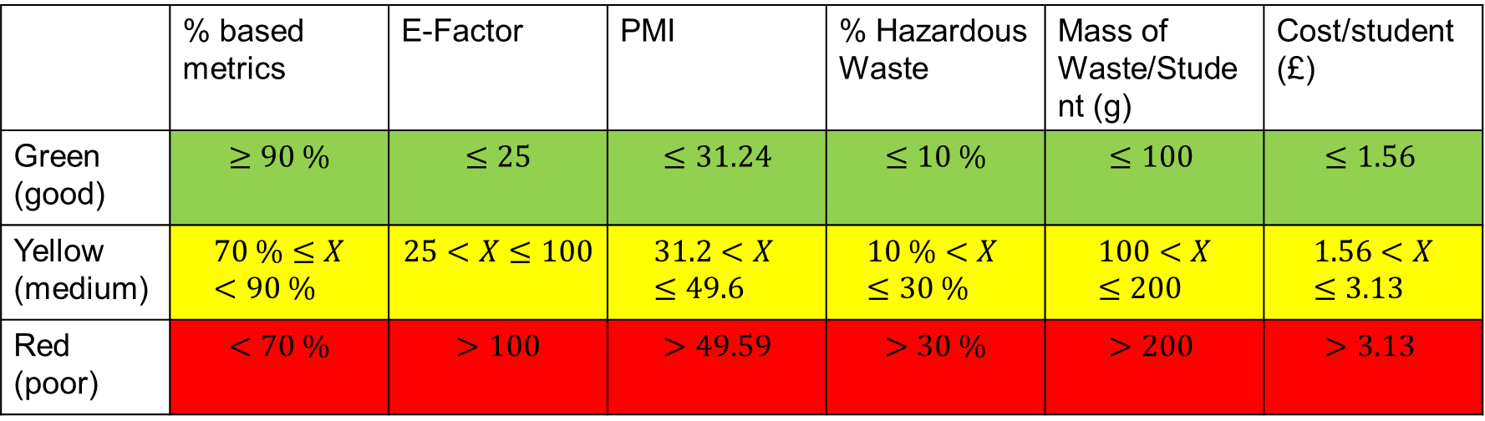
Preparation of 3-Methylbutyl Acetate
Skills:
Reflux Reaction
Separating Funnel
Distillation
Atom Efficiency | Average Percentage Yield | Average E-Factor | Average Reaction Mass Efficiency | Process Mass Intensity (PMI)
53 % | 50 % | 30.7 | 24 % | 31.7
 | Mass of product | Mass of Waste Generated | Mass of Hazardous Waste
Student X | 10.8 g | 332 g | 18.2 g
Student X is representative of a student who achieved an average yield in this experiment.
 | Estimated Energy Usage (Hot Plates, Heat Gun) | Estimated Cost of Reagents
Student X | 0.325 kWh | £6.24
Percentage Yield and E-Factor for Y1O-001
Range of Percentage Yield Values in a Cohort Compared with E-Factor
Shows how E-factor and percentage yield are related, and how a yield of 70 % or higher results in a ‘green’ E-factor. A yield of 20% or higher results in ‘yellow’ E-factor.
Shows how only students achieving a percentage yield above the upper quartile will have a good E-factor. Also shows that most students will achieve a good or moderate E-factor.
 | % based metrics | E-Factor | PMI | % Hazardous Waste | Mass of Waste/Student (g) | Cost/student (£)
Green (good) | $$≥90 \%$$ | $$≤25$$ | $$≤31.24$$ | $$≤10 \%$$ | $$≤100$$ | $$≤1.56$$
Yellow (medium) | $$70 \%≤X<90 \%$$ | $$25<X≤100$$ | $$31.2<X ≤49.6$$ | $$10 \%<X ≤30 \%$$ | $$100<X≤200$$ | $$1.56<X≤3.13$$
Red (poor) | $$<70 \%$$ | $$>100$$ | $$>49.59$$ | $$>30 \%$$ | $$>200$$ | $$>3.13$$

Slide 2
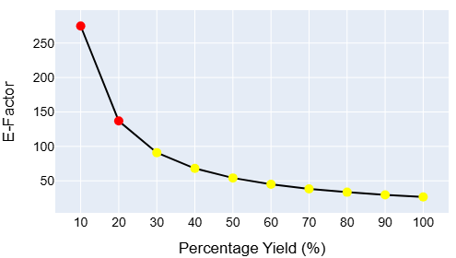
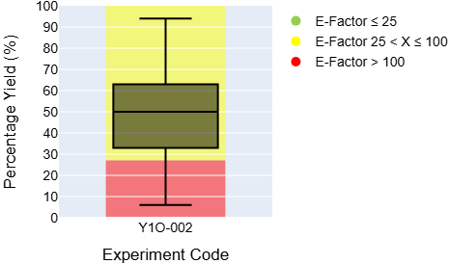
Preparation of Paracetamol
Skills:
Büchner Filtration
Recrystallisation
Atom Efficiency | Average Percentage Yield | Average E-Factor | Average Reaction Mass Efficiency | Process Mass Intensity (PMI)
72 % | 48 % | 56.4 | 31 % | 57.4
 | Mass of product | Mass of Waste Generated | Mass of Hazardous Waste
Student X | 1.45 g | 81.8 g | 18.2 g
Student X is representative of a student who achieved an average yield in this experiment.
 | Estimated Energy Usage (Hot Plates) | Estimated Cost of Reagents
Student X | 0.037 kWh | £1.22
Percentage Yield and E-Factor for Y1O-002
Range of Percentage Yield Values in a Cohort Compared with E-Factor
Shows how E-factor and percentage yield are related, and how a percentage yield of 30 % or higher results in a ‘yellow’ E-factor.
Shows how more than 75 % of students will achieve a moderate E-factor, but it is not possible for students to get a good E-factor in this experiment.
 | % based metrics | E-Factor | PMI | % Hazardous Waste | Mass of Waste/Student (g) | Cost/student (£)
Green (good) | $$≥90 \%$$ | $$≤25$$ | $$≤31.24$$ | $$≤10 \%$$ | $$≤100$$ | $$≤1.56$$
Yellow (medium) | $$70 \%≤X<90 \%$$ | $$25<X≤100$$ | $$31.2<X ≤49.6$$ | $$10 \%<X ≤30 \%$$ | $$100<X≤200$$ | $$1.56<X≤3.13$$
Red (poor) | $$<70 \%$$ | $$>100$$ | $$>49.59$$ | $$>30 \%$$ | $$>200$$ | $$>3.13$$

Slide 3
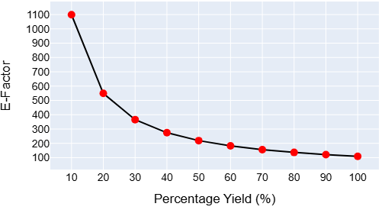
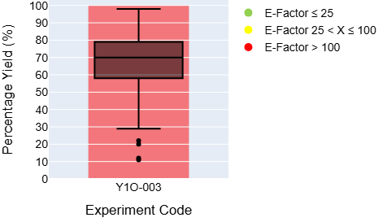
Preparation of Diphenylmethanol
Skills:
TLC to monitor a reaction
Büchner filtration
Recrystallisation
Atom Efficiency | Average Percentage Yield | Average E-Factor | Average Reaction Mass Efficiency | Process Mass Intensity (PMI)
84 % | 67 % | 163 | 55 % | 164
 | Mass of product | Mass of Waste Generated | Mass of Hazardous Waste
Student X | 0.493 g | 80.5 g | 37.1 g
Student X is representative of a student who achieved an average yield in this experiment.
 | Estimated Energy Usage (Hot Plates) | Estimated Cost of Reagents
Student X | 0.003 kWh | £2.24
Percentage Yield and E-Factor for Y1O-003
Range of Percentage Yield Values in a Cohort Compared with E-Factor
Shows how E-factor and percentage yield are related, and how for any percentage yield, this experiment will have a ‘red’ E-factor as for each 1 g of product there is more than 100 g of waste.
Shows how it is only possible for students to achieve a poor E-factor from this experiment. Even a 100 % yield will result in a poor E-factor.
 | % based metrics | E-Factor | PMI | % Hazardous Waste | Mass of Waste/Student (g) | Cost/student (£)
Green (good) | $$≥90 \%$$ | $$≤25$$ | $$≤31.24$$ | $$≤10 \%$$ | $$≤100$$ | $$≤1.56$$
Yellow (medium) | $$70 \%≤X<90 \%$$ | $$25<X≤100$$ | $$31.2<X ≤49.6$$ | $$10 \%<X ≤30 \%$$ | $$100<X≤200$$ | $$1.56<X≤3.13$$
Red (poor) | $$<70 \%$$ | $$>100$$ | $$>49.59$$ | $$>30 \%$$ | $$>200$$ | $$>3.13$$

Slide 4
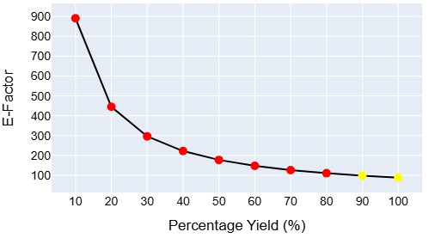
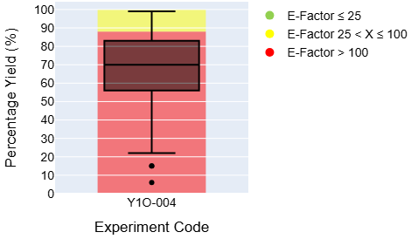
Preparation of 4-Nitroaniline
Skills:
Reflux Reaction
Büchner Filtration
Recrystallisation
Atom Efficiency | Average Percentage Yield | Average E-Factor | Average Reaction Mass Efficiency | Process Mass Intensity (PMI)
50 % | 68 % | 130 | 10 % | 131
 | Mass of product | Mass of Waste Generated | Mass of Hazardous Waste
Student X | 1.56 g | 204 g | 55.1 g
Student X is representative of a student who achieved an average yield in this experiment.
 | Estimated Energy Usage (Hot Plates) | Estimated Cost of Reagents
Student X | 0.0717 kWh | £6.98
Percentage Yield and E-Factor for Y1O-004
Range of Percentage Yield Values in a Cohort Compared with E-Factor
Shows how E-factor and percentage yield are related, and how for a yield of 90 % or higher results in a ‘yellow’ E-factor.
Shows how more than 75 % of students will achieve a poor E-factor, with only the highest yielding students achieving a moderate E-factor.
 | % based metrics | E-Factor | PMI | % Hazardous Waste | Mass of Waste/Student (g) | Cost/student (£)
Green (good) | $$≥90 \%$$ | $$≤25$$ | $$≤31.24$$ | $$≤10 \%$$ | $$≤100$$ | $$≤1.56$$
Yellow (medium) | $$70 \%≤X<90 \%$$ | $$25<X≤100$$ | $$31.2<X ≤49.6$$ | $$10 \%<X ≤30 \%$$ | $$100<X≤200$$ | $$1.56<X≤3.13$$
Red (poor) | $$<70 \%$$ | $$>100$$ | $$>49.59$$ | $$>30 \%$$ | $$>200$$ | $$>3.13$$

Slide 5
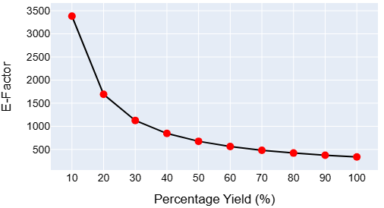
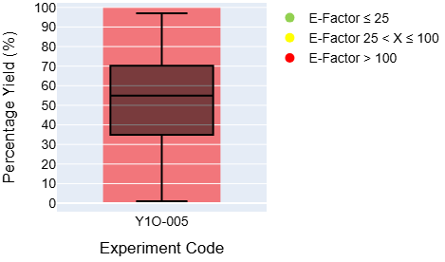
Oxidation of 9-Fluorenol
Skills:
TLC to monitor a reaction
Separating Funnel
Rotary evaporator to remove solvent
Recrystallisation
Atom Efficiency | Average Percentage Yield | Average E-Factor | Average Reaction Mass Efficiency | Process Mass Intensity (PMI)
57 % | 51 % | 663 | 4 % | 664
 | Mass of product | Mass of Waste Generated | Mass of Hazardous Waste
Student X | 0.252 g | 167 g | 106 g
Student X is representative of a student who achieved an average yield in this experiment.
 | Estimated Energy Usage (Hot Plate, Chiller, Rotary Evaporator) | Estimated Cost of Reagents
Student X | 0.304 kWh | £7.01
Percentage Yield and E-Factor for Y1O-005
Range of Percentage Yield Values in a Cohort Compared with E-Factor
Shows how E-factor and percentage yield are related, and how for any percentage yield, this experiment will have a ‘red’ E-factor as for each 1 g of product there is more than 100 g of waste.
Shows how it is only possible for students to achieve a poor E-factor from this experiment. Even a 100 % yield will result in a poor E-factor.
 | % based metrics | E-Factor | PMI | % Hazardous Waste | Mass of Waste/Student (g) | Cost/student (£)
Green (good) | $$≥90 \%$$ | $$≤25$$ | $$≤31.24$$ | $$≤10 \%$$ | $$≤100$$ | $$≤1.56$$
Yellow (medium) | $$70 \%≤X<90 \%$$ | $$25<X≤100$$ | $$31.2<X ≤49.6$$ | $$10 \%<X ≤30 \%$$ | $$100<X≤200$$ | $$1.56<X≤3.13$$
Red (poor) | $$<70 \%$$ | $$>100$$ | $$>49.59$$ | $$>30 \%$$ | $$>200$$ | $$>3.13$$

Slide 6
Preparation of…
Skills:
Atom Efficiency | Average Percentage Yield | Average E-Factor | Average Reaction Mass Efficiency | Process Mass Intensity (PMI)
 | Mass of product | Mass of Waste Generated | Mass of Hazardous Waste
Student X
Student X is representative of a student who achieved an average yield in this experiment.
 | Estimated Energy Usage | Estimated Cost of Reagents
Student X
Percentage Yield and E-Factor for…
Range of Percentage Yield Values in a Cohort Compared with E-Factor
 | % based metrics | E-Factor | PMI | % Hazardous Waste | Mass of Waste/Student (g) | Cost/student (£)
Green (good) | $$≥90 \%$$ | $$≤25$$ | $$≤31.24$$ | $$≤10 \%$$ | $$≤100$$ | $$≤1.56$$
Yellow (medium) | $$70 \%≤X<90 \%$$ | $$25<X≤100$$ | $$31.2<X ≤49.6$$ | $$10 \%<X ≤30 \%$$ | $$100<X≤200$$ | $$1.56<X≤3.13$$
Red (poor) | $$<70 \%$$ | $$>100$$ | $$>49.59$$ | $$>30 \%$$ | $$>200$$ | $$>3.13$$

